Slide 1


Slide 2
Objective
Supervised learning
Regression
Square Mean Error
Gradient Descent
Example
Practice
Classification
Performance Measures
Example
Practice
Notes:
In London

Slide 3
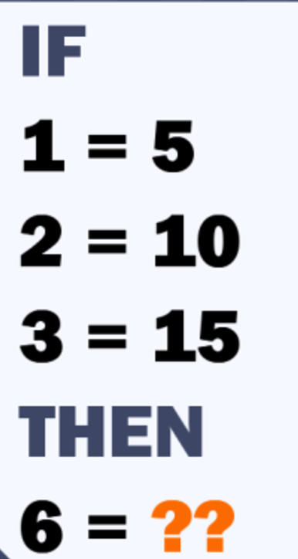
Only For Genius Quiz
Notes:
In London

Slide 4
Regression continuous function

Slide 5
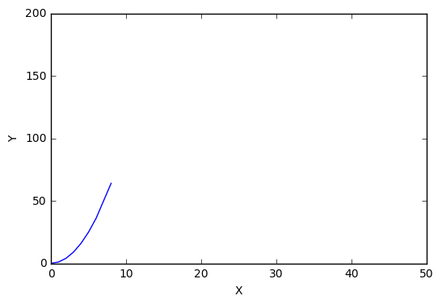
Regression
Predict results within a continuous output, meaning that we are trying to map input variables to some continuous function
Learn from existing data
Helps in establishing association or independence hypothesis
Helps in predicting future values based on past occurrences
Y = [0, 1, 4, 9, 16, 25, 36, 64]
X = [0, 1, 2, 3, 4, 5, 6, 8]
Notes:
In London

Slide 6
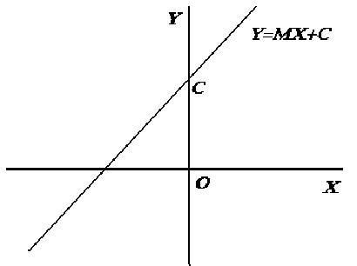
Linear Regression
When the relationship between independent variable and dependent variable is linear.
Y = a + bX
Estimated value Y_{i} = a + bX_{i} + e_{i}
Notes:
In London

Slide 7
Regression
Given data about the size of houses on the real estate market, try to predict their price. Price as a function of size is a continuous output, so this is a regression problem.
Notes:
In London

Slide 8
Regression
Predicting value of “dependent variable” (say Y) for value of ”independent variable” (say X).
Assumption is, Y varies with X
We are predicting the values, there are going to be errors in predictions.
Our goal is to minimize these errors.
If actual Y = 10 and observed Y’ = 11, we have an error of |1| unit. Our goal should be to minimize this error, such that error tends to 0.
Notes:
In London

Slide 9
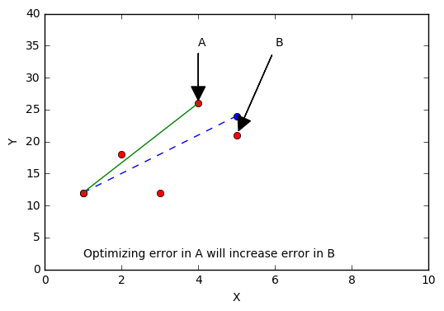
Linear Regression
If we optimize observed errors individually then other errors would increase in magnitude.
Notes:
In London

Slide 10
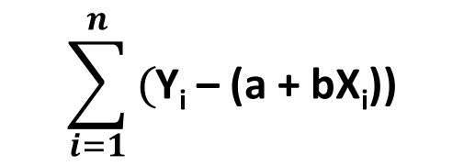
Error Function
Thus, we should try to make sum of all errors as close as possible to zero. This will minimize overall error and make over all predictions better.
So, this sum should be minimized, right?
$$\sum_{i=1}^{n}{\text{(}\text{Y}\text{i}\text{ – (}\text{a}\text{ + }\text{bXi}\text{)) }}$$
Notes:
In London

Slide 11
Error Function
Sum can be made zero by many choices of totally unsuitable lines. Negative and positive values will cancel out. Sum of large variations can also become zero.
7
4
-4
-7
Notes:
In London

Slide 12
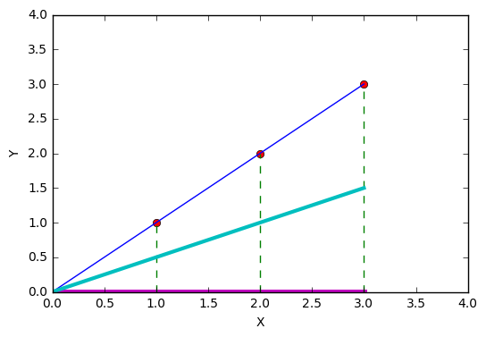
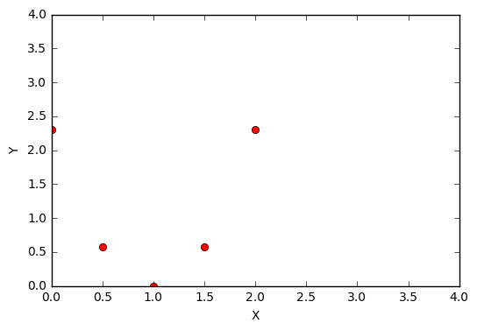
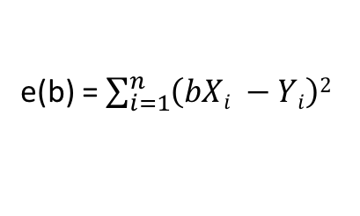
Linear Regression
e(b) = $\sum_{i=1}^{n}{\left(bXi −Yi\right)2}$
Y(X) = bX
*Divided by 2n
As expected, we have best fit one e(b) is minimum i.e. 0 at b = 1 and line of regression has minimum error.
Notes:
In London

Slide 13
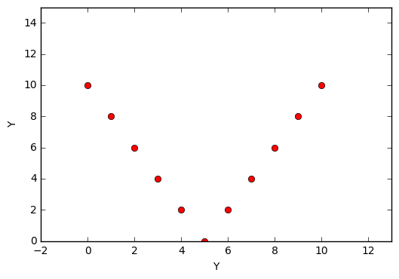
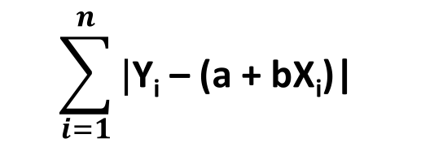

Linear Regression
We can use absolute sum of errors.
$$\sum_{i=1}^{n}{\text{|}\text{Y}\text{i}\text{ – (}\text{a}\text{ + }\text{bXi}\text{)| }}$$
$$\text{|}\text{Y}\text{i}\text{ – (}\text{a}\text{ + }\text{bXi}\text{)|}$$
Notes:
In London

Slide 14
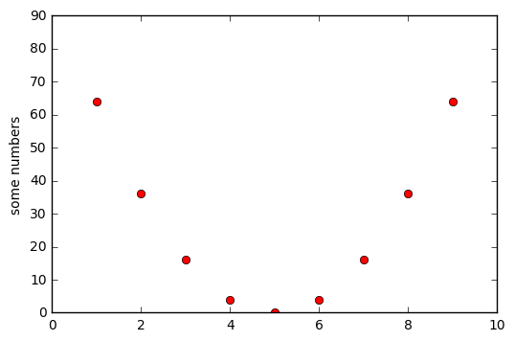
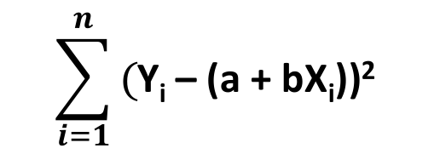

Cost Function
We can use squared sum of errors.
$$\sum_{i=1}^{n}{\text{(}\text{Y}\text{i}\text{ – (}\text{a}\text{ + }\text{bXi}\text{))2 }}$$
$$e\text{ = }\text{(}\text{Y}\text{i}\text{ – (}\text{a}\text{ + }\text{bXi}\text{))2}$$
Notes:
In London

Slide 15
Cost function
These minimization functions are also known as cost functions.
We have already seen two of the cost functions, there could be many cost functions. In practice, Squared sum of errors or least square sum is the one which is being used the most.
Squared errors give us a more uniformly distributed graph. With nice mathematical properties. It is convenient to work with. Uniformly differentiable.
That said, there are different school of thoughts regarding absolute sum and square sum.
Notes:
In London

Slide 16
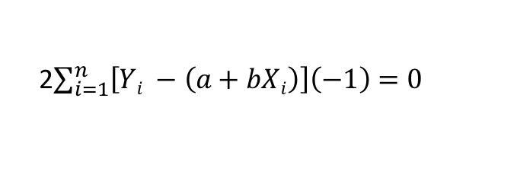
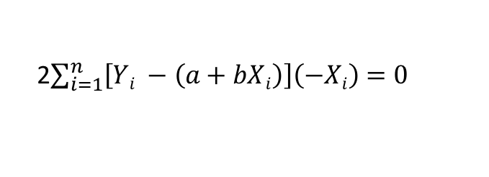
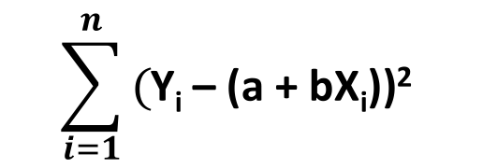
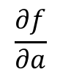
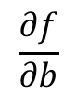
Linear Regression
Thus, a necessary condition for relative minimum is vanishing of the partial derivatives with respect to a and b. We thus have:
$$\frac{∂f}{∂a}$$
$$\sum_{i=1}^{n}{\text{(}\text{Y}\text{i}\text{ – (}\text{a}\text{ + }\text{bXi}\text{))2 }}$$
2$\sum_{i=1}^{n}{\left[Yi −\left(a+bXi\right)\right]\left(−1\right)=0}$
$$\frac{∂f}{∂b}$$
2$\sum_{i=1}^{n}{\left[Yi −\left(a+bXi\right)\right]\left(−Xi\right)=0}$
Notes:
In London

Slide 17
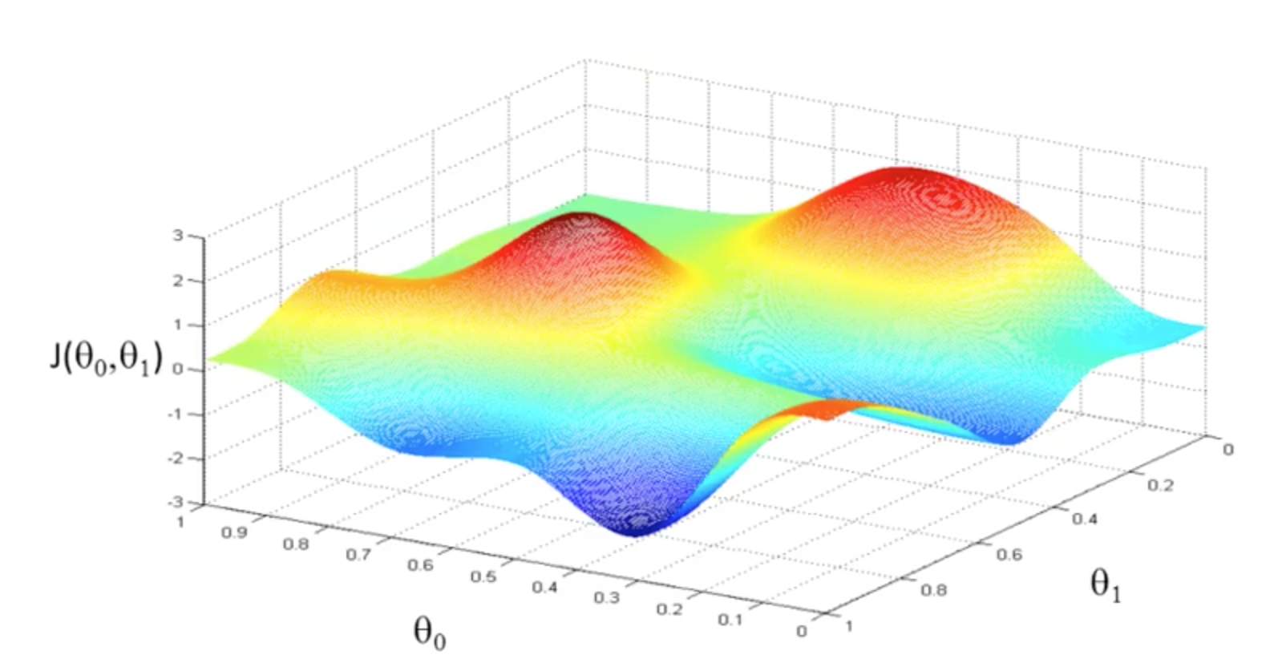
Linear Regression – Gradient Descent
Notes:
In London

Slide 18

Linear Regression – Gradient Descent
Notes:
In London

Slide 19
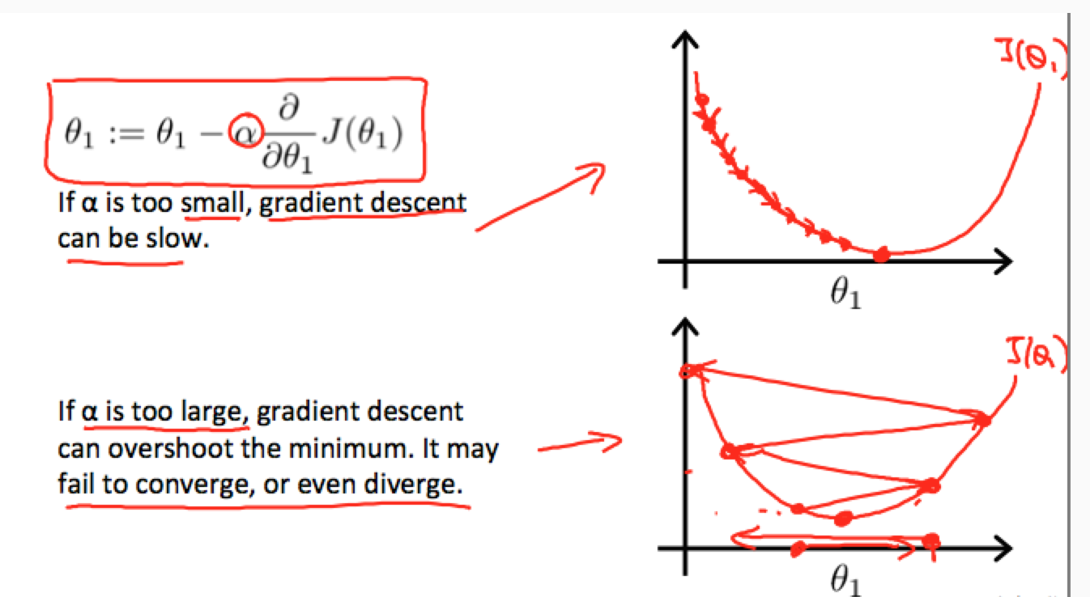
Linear Regression – Gradient Descent
Notes:
In London

Slide 20
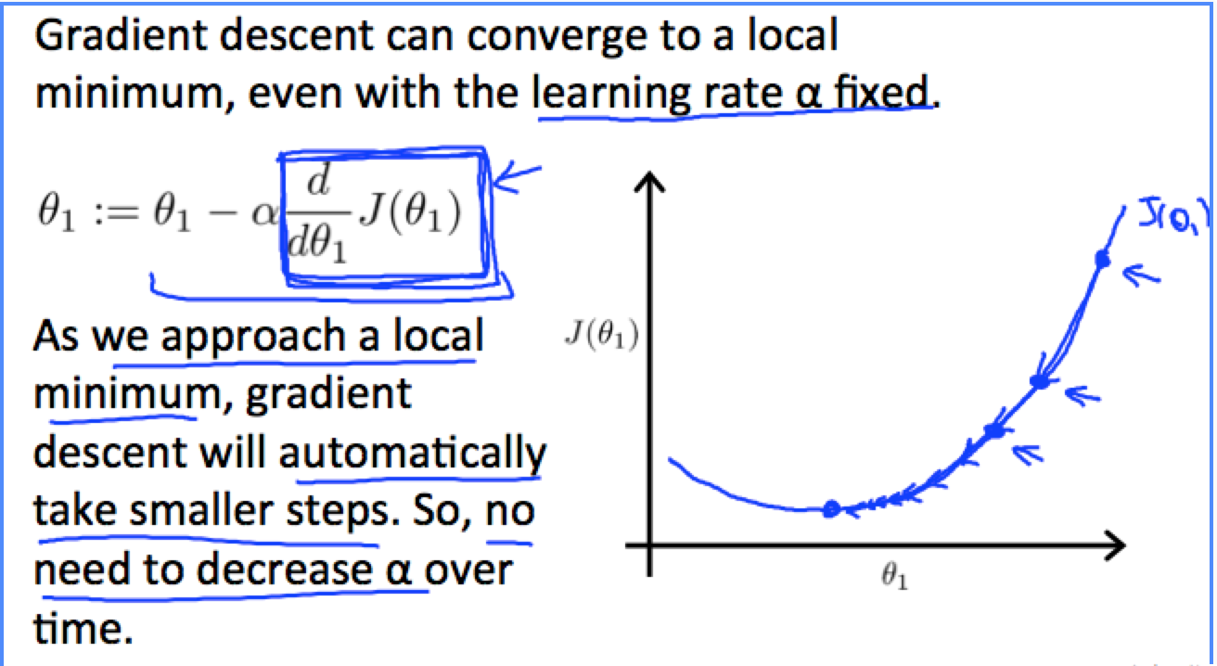
Linear Regression – Gradient Descent
Notes:
In London

Slide 21
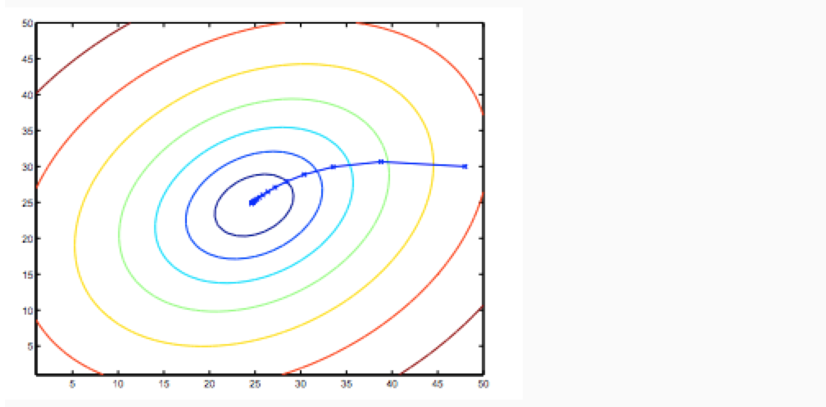
Linear Regression – Gradient Descent
Notes:
In London

Slide 22
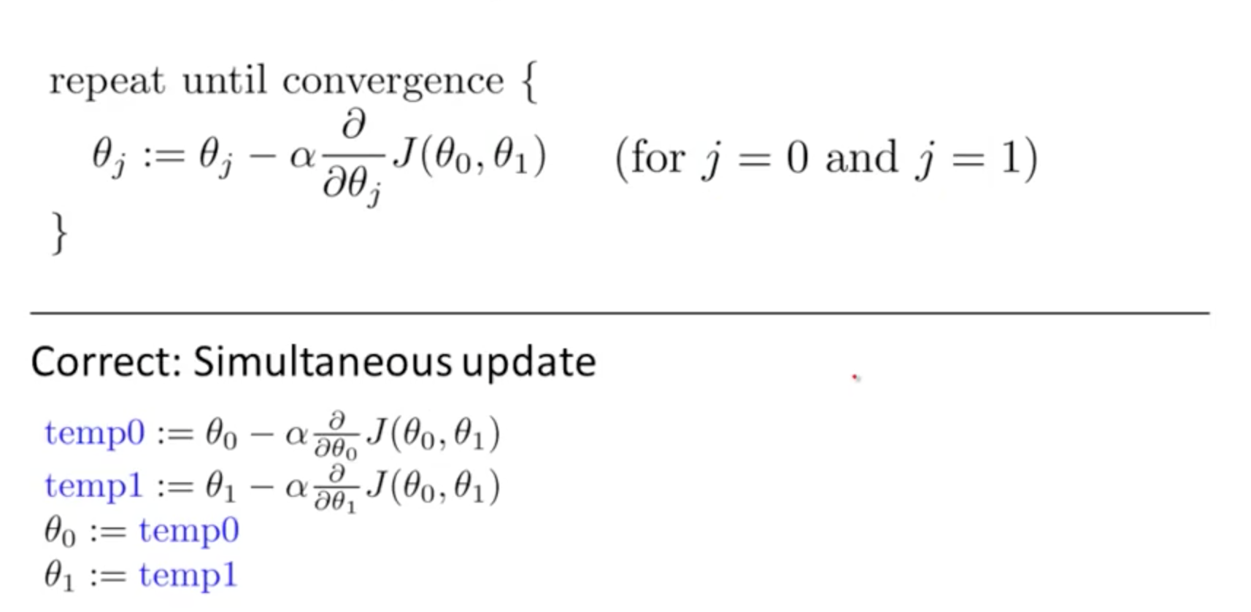
Linear Regression – Gradient Descent
http://www.onmyphd.com/?p=gradient.descent
Notes:
http://www.onmyphd.com/?p=gradient.descent

Slide 23
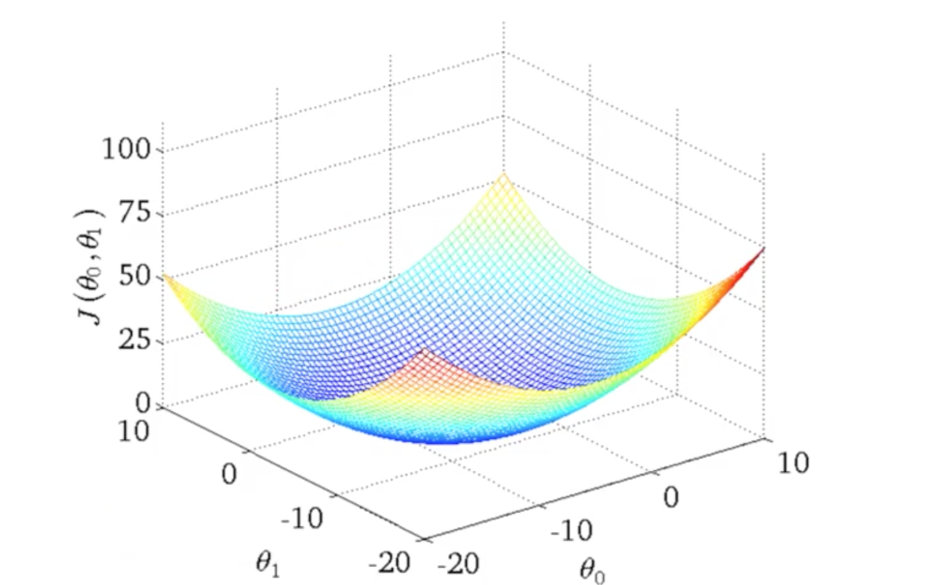
Linear Regression
Notes:
In London

Slide 24
Practice time

Slide 25
Classification discrete categories

Slide 26
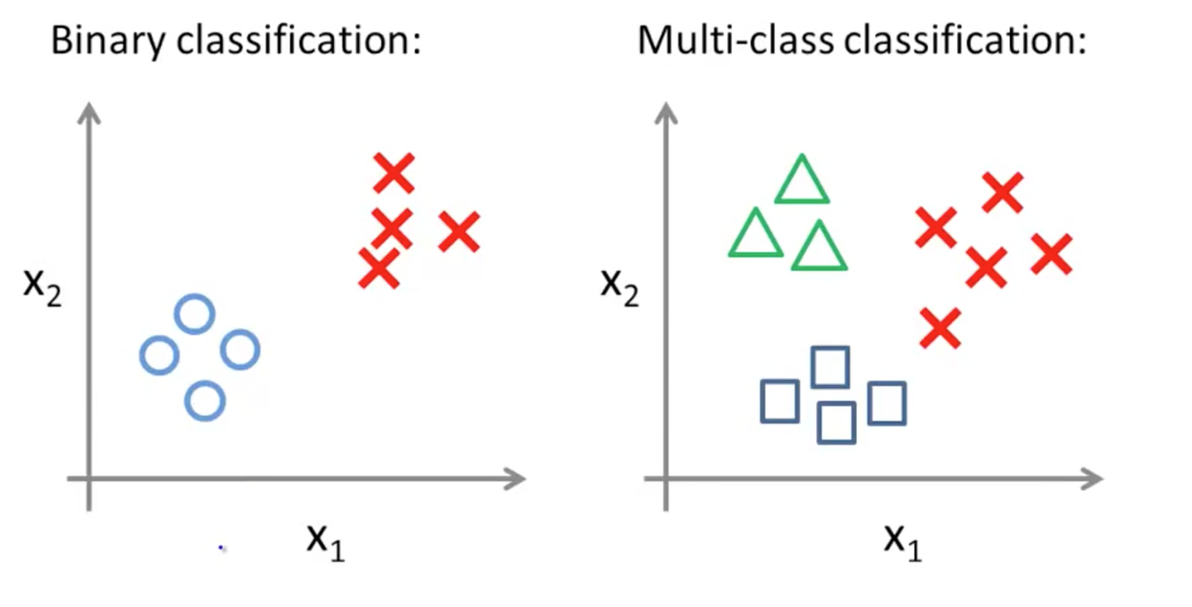
Binary vs Multi Class Classification
Notes:
Cannot use the same one as logistic regression due to non convex nature of the cost function,multiple local minimaz no single way for the gradient descent to converge. Cost(hθ(x),y)=0 if hθ(x)=yCost(hθ(x),y)→∞ if y=0andhθ(x)→1Cost(hθ(x),y)→∞ if y=1andhθ(x)→0

Slide 27
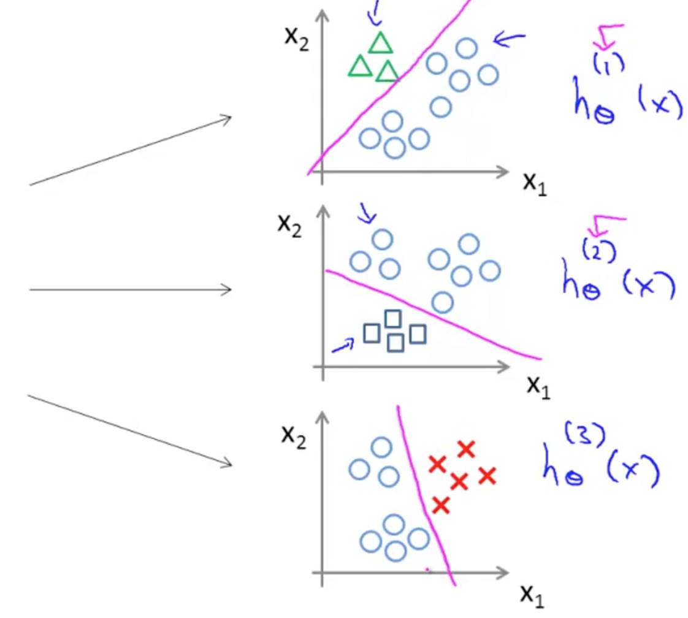
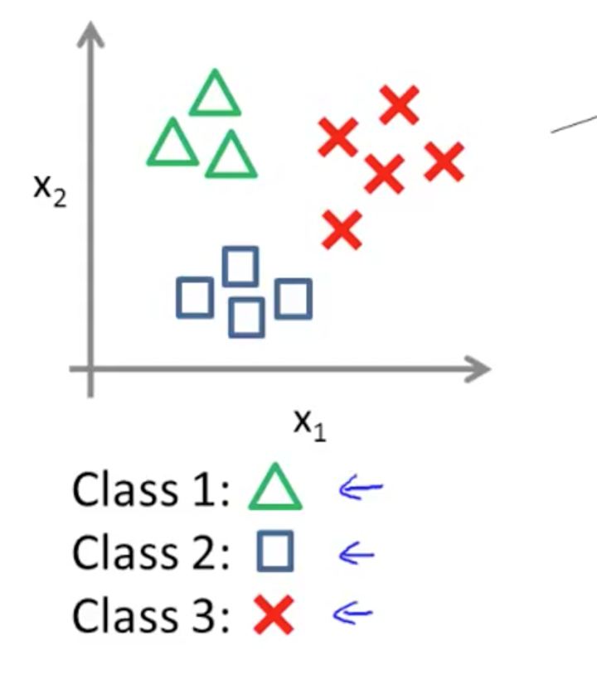
One vs all Classification
Notes:
Train a logistic regression classifier hθ(x) for each class￼ to predict the probability that ￼ ￼y = i￼ ￼.
To make a prediction on a new x, pick the class ￼that maximizes hθ(x)

Slide 28
Classification
To attempt classification, one method is to use linear regression
predictions greater than 0.5 as a 1
all less than 0.5 as a 0.
However, this method doesn't work well because classification
y can take on only two values, 0 and 1. For instance, if we are trying to build a spam classifier for email, then x(i) may be some features of a piece of email, and y may be 1 if it is a piece of spam mail, and 0 otherwise. Hence, y∈{0,1}. 0 is also called the negative class, and 1 the positive class.

Slide 29
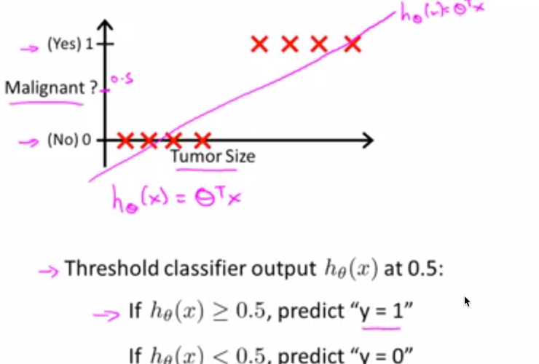
Linear Function

Slide 30
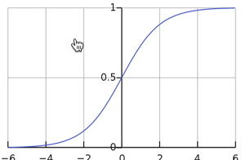
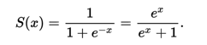
Sigmoid Function

Slide 31
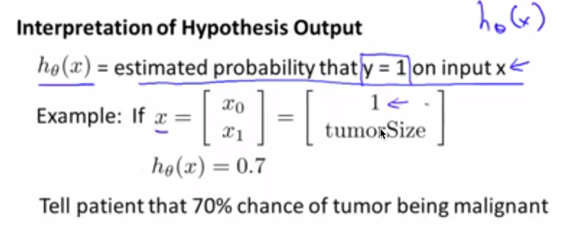

Slide 32
Choosing a classifier
Batch gradient descent
Consider all the datapoint for calculating cost
Slow for large dataset
Stochastic gradient descent
Consider only one or mini batch data
Fast for large dataset

Slide 33
Performance Measures
Measuring Accuracy Using Cross-Validation
Confusion Matrix

Slide 34
Measuring Accuracy Using Cross-Validation
One way to evaluate the Decision Tree model would be to use the train_test_split function to split the training set into a smaller training set and a validation set, then train your models against the smaller training set and evaluate them against the validation set.
K-fold cross-validation: K-fold cross-validation means splitting the training set into K-folds then making predictions and evaluating them on each fold using a model trained on the remaining folds

Slide 35
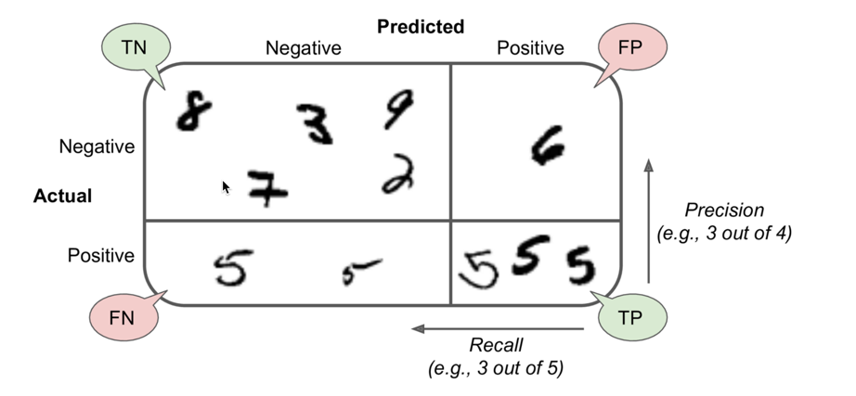
Confusion Matrix
Notes:
In London

Slide 36

Confusion Matrix
Notes:
In London

Slide 37
Precision and Recall
Precision = TP / (TP + TN)
Recall = TP / (TP + FN)
Notes:
In London

Slide 38
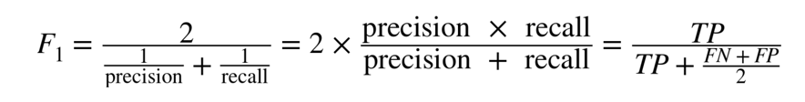
F1 Score
The F₁ score is the harmonic mean of precision and recall (Equation 3-3). Whereas the regular mean treats all values equally, the harmonic mean gives much more weight to low values. As a result, the classifier will only get a high F₁ score if both recall and precision are high.
The F₁ score favors classifiers that have similar precision and recall. This is not always what you want: in some contexts you mostly care about precision, and in other contexts you really care about recall.
Example: If you trained a classifier to detect videos that are safe for kids, you would probably prefer a classifier that rejects many good videos (low recall) but keeps only safe ones (high precision)

Slide 39
Practice time

